Slide 1

Council Growth Through Membership
Carl Schneider
Membership Director
New York State Council
Knights of Columbus

Slide 2
Fraternal Year 2025-26
A Vision for Growth and Excellence
Our goal is to enhance the vitality of every council in New York State
Increase membership
Support council leadership
Promote programs that reflect our core principles

Slide 3
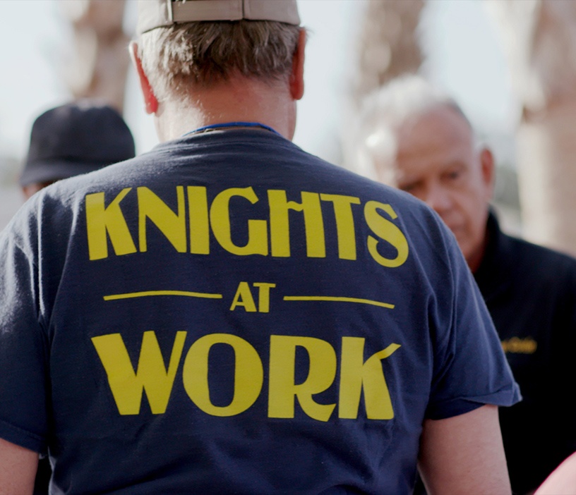
Success Begins With the Letter R
Recruit
Retain
Revitalize

Slide 4
Success Begins With the Letter R
Reflection
Renewal

Slide 5
In the life of every man, there arise many opportunities to take stock of his advancement, both in the spiritual and material sense, to repair omissions , to correct errors and to plan for a brighter future. This moment marks a new beginning for our councils –a chance to assess our progress , recommit to our mission, and chart a path toward a stronger more vibrant future.
Intallation of Council Officers

Slide 6
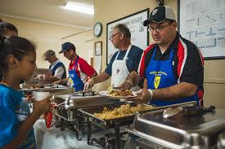
Together, we can make a difference!
One Council, One Community, One Life at a time!

